Slide 1


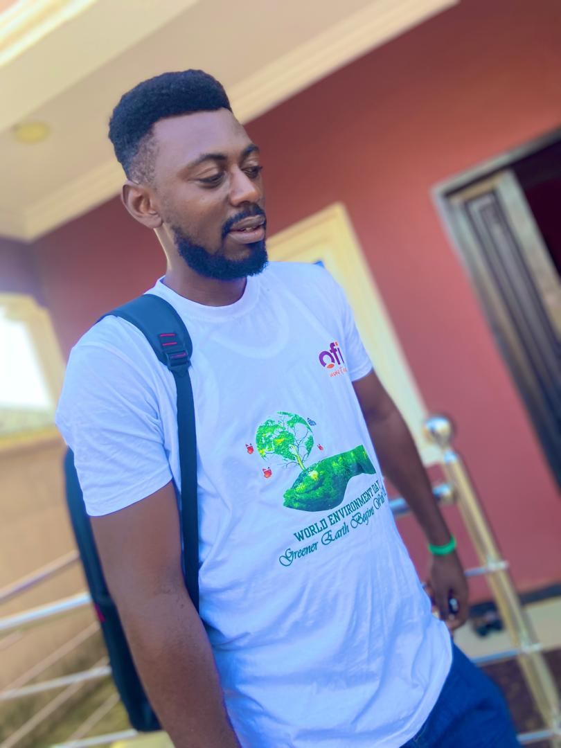
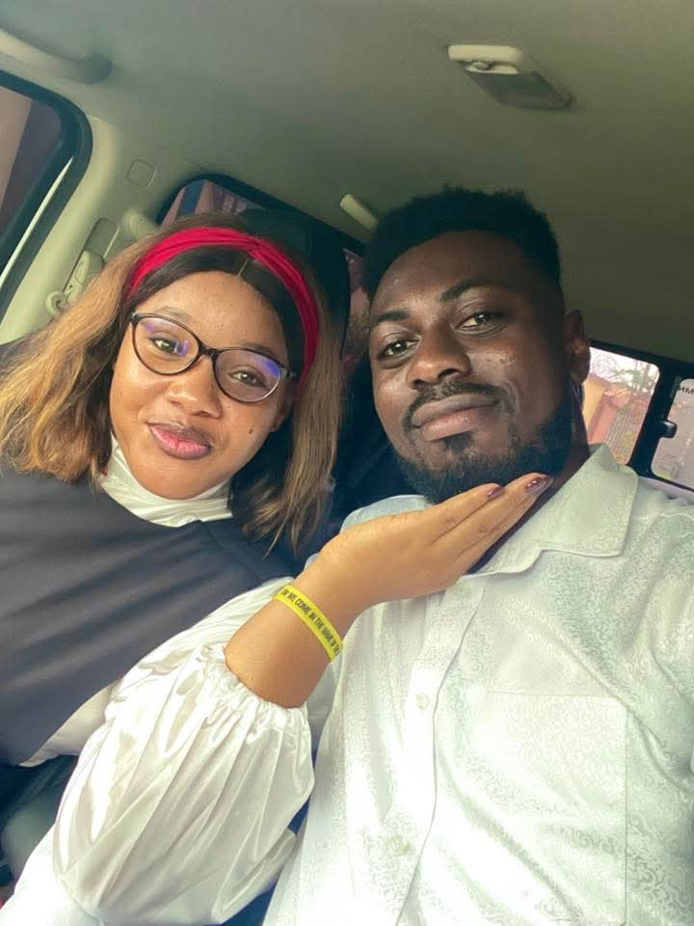
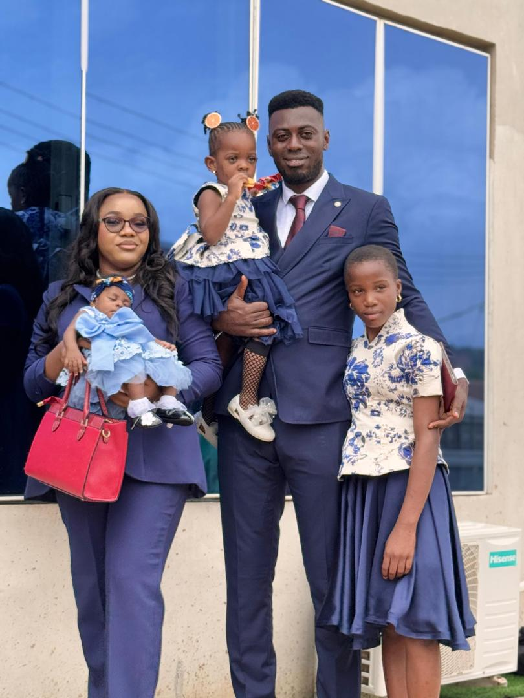
Getting to Know Me
Work
Personal
My role
Sustainability Operation Lead – ofi Nigeria
Significant others / family members / furry friends in my life
My Family: Wife, Parents, Sister and Adorable daughters.
Tenure in ofi/Olam
5 years
How I enjoy spending my free time
Spending time with Family – Picnic and travelling
Previous companies I have worked at
None
My favorite / comfort food
Egusi Soup and Semo with lots of assorted.
Why I joined ofi/Olam and what keeps me here?
Career growth and development/ Career growth opportunities and feeling valued and recognized.
My favorite song
Heal the world – Michael Jackson
Samuel Ogbonnaya
‘what name you prefer to be called’ Sammy
A few fun facts about me
Im a hardworker, loves football (support Arsenal FC) and value relationships and family.
This is me outside work, doing stuff I enjoy in my life …

